Slide 1
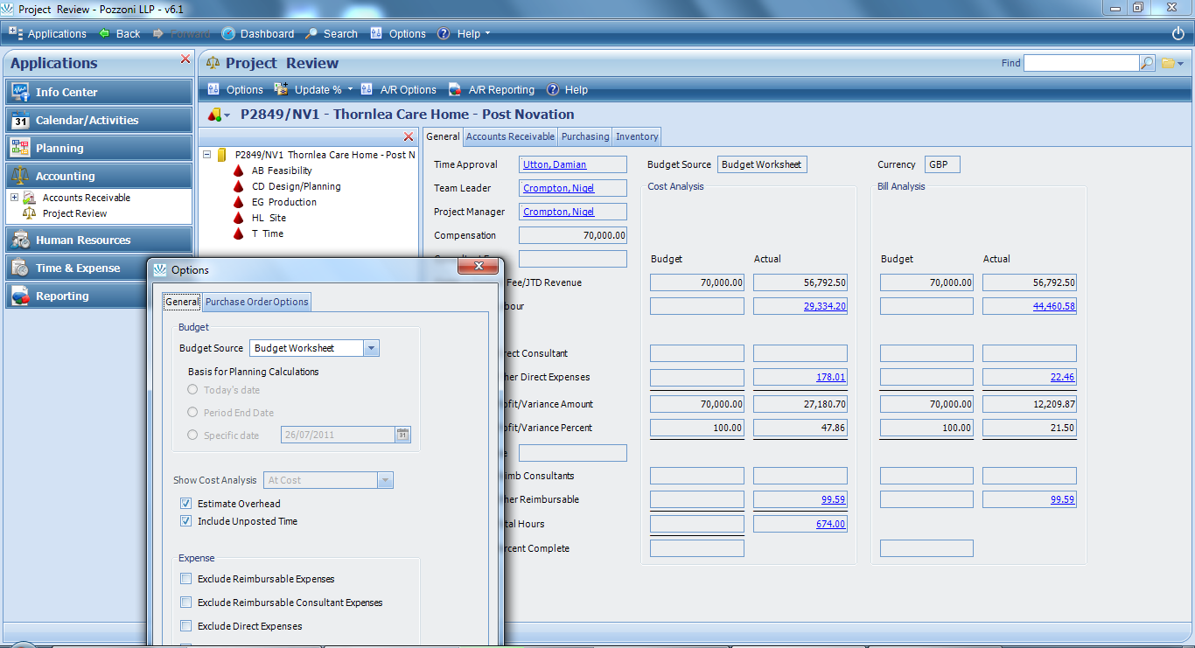
1
Click Accounting
/ Project Review
2
Click Options
4
search and select project / projects
Analysis
Invoicing
Analysis
drill down blue txt
3
Tick to include unposted hours
Project Review – for interactive project analysis

